Slide 1
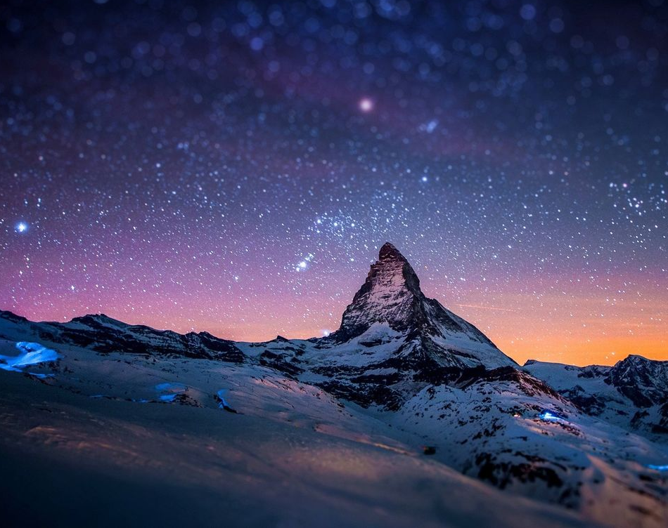
All sufficient merit

Slide 2
All sufficient merit
Shining like the sun
A fortune I inherit
By no work I have done

Slide 3
My righteousness I forfeit
At my saviors cross
Where all sufficient merit
Did what I could not

Slide 4
In love he condescended
Eternal now in time
A life without a blemish
The maker made to die

Slide 5
The Law could never save us
Our lawlessness had won
Until the pure and spotless
Lamb had finally come

Slide 6
It is done
It is finished
No more debt I owe

Slide 7
Paid in full
All sufficient merit now my own

Slide 8
I lay down my garments
Any empty boast
Good works now all corrupted
By the sinful host

Slide 9
I’m dressed in my LORD Jesus
A crimson robe made white
No more fear of judgement
His righteousness is mine

Slide 10
It is done
It is finished
No more debt I owe

Slide 11
Paid in full
All sufficient merit now my own

Slide 12
All sufficient merit
Firm in life and death
The joy of my salvation
Shall be my final breath

Slide 13
When I stand accepted
Before the throne of God
I’ll gaze upon my Jesus
And thank Him for the cross
Yes I’ll thank Him for the cross

Slide 14
It is done
It is finished
No more debt I owe

Slide 15
Paid in full
All sufficient merit now my own
(Oh your merit now my own)

Slide 16
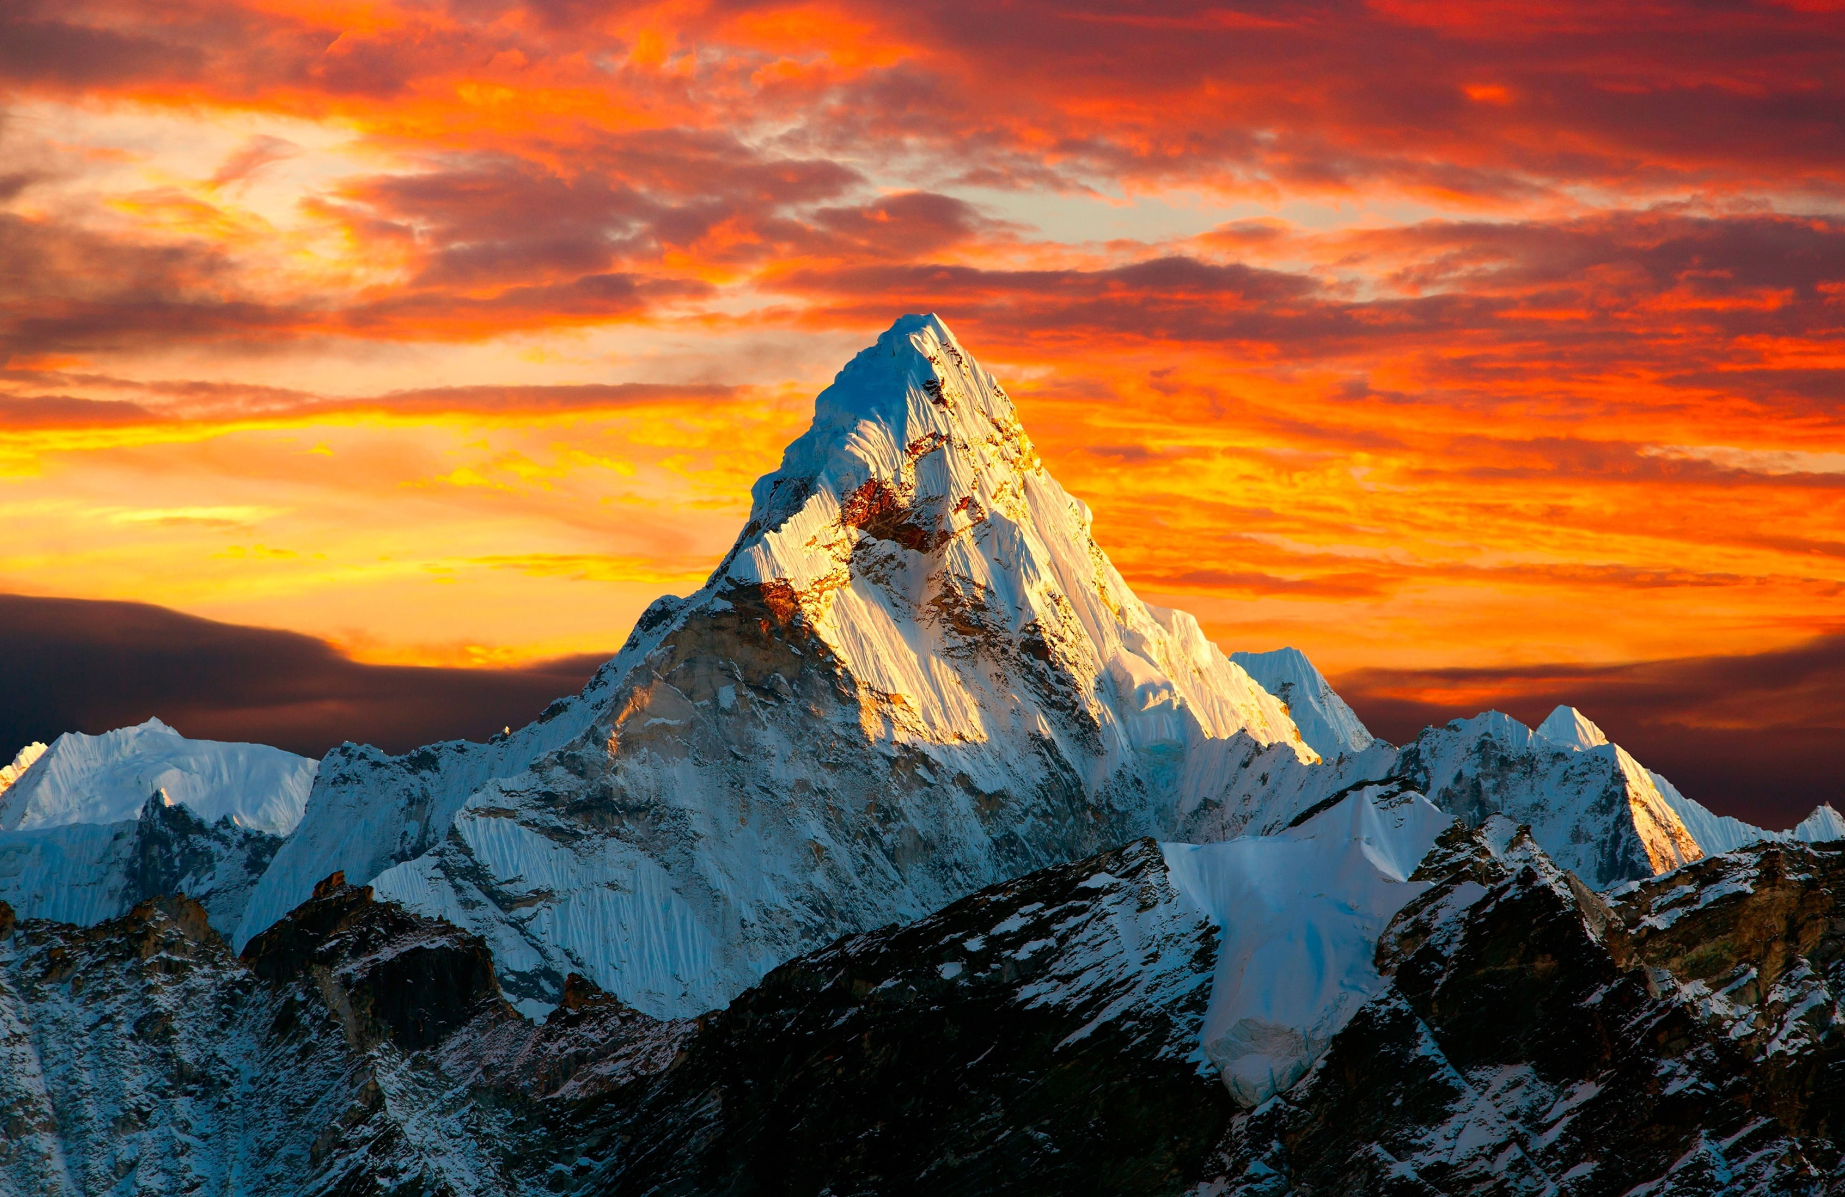
Only A Holy God

Slide 17
Who else commands all the hosts of heaven?
Who else could make every king bow down?
Who else can whisper and darkness trembles?
Only a Holy God

Slide 18
What other beauty demands such praises?
What other splendor outshines the sun?
What other majesty rules with justice?
Only a Holy God

Slide 19
Come and behold Him
The One and the Only
Cry out, sing holy
Forever a Holy God
Come and worship the Holy God

Slide 20
What other glory consumes like fire?
What other power can raise the dead?
What other name remains undefeated?
Only a Holy God

Slide 21
Come and behold Him
The One and the Only
Cry out, sing holy
Forever a Holy God
Come and worship the Holy God

Slide 22
Who else could rescue me from my failing?
Who else would offer His only Son?
Who else invites me to call Him Father?
Only a Holy God
Only my Holy God

Slide 23
Come and behold Him
The One and the Only
Cry out, sing holy
Forever a Holy God
Come and worship the Holy God

